Slide 1

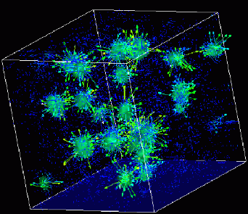
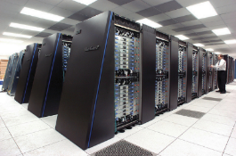
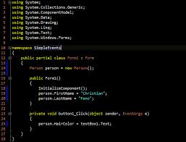
Advanced
Scientific Computing
(SciComp 201)
Session 33
Managing Data Files

Slide 2
Session Goals
Learn about the underlying statistics of Random Walks
Develop code to read & write C++ data files using stream operators
Text mode = likely in ASCII or UTF-8, editable in Notepad
Binary mode = encoded, unreadable by text processors
Generate and parse files using the comma separated values (CSV) format
Delineates distinct columns with a comma
Easy import/export with Excel and most applications

Slide 3
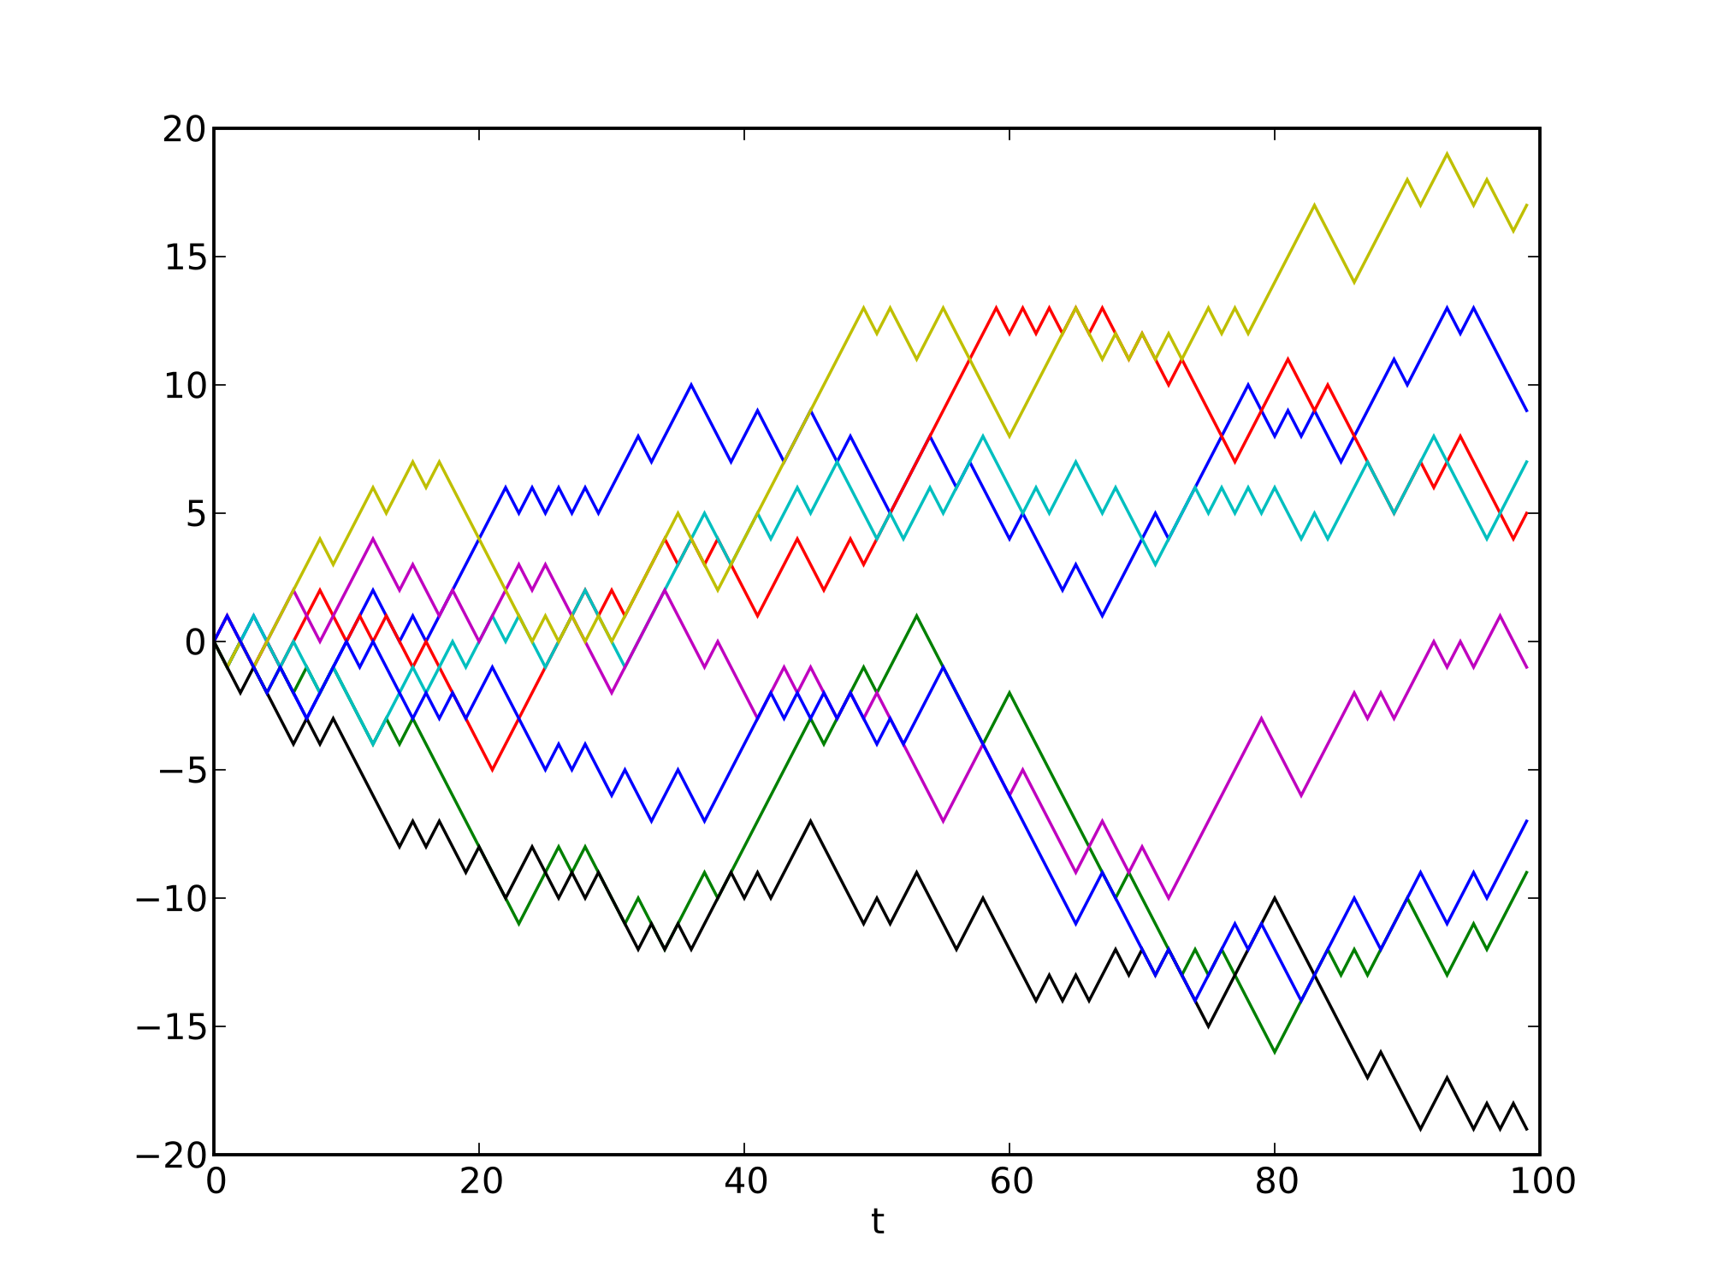
Random Walks

Slide 4
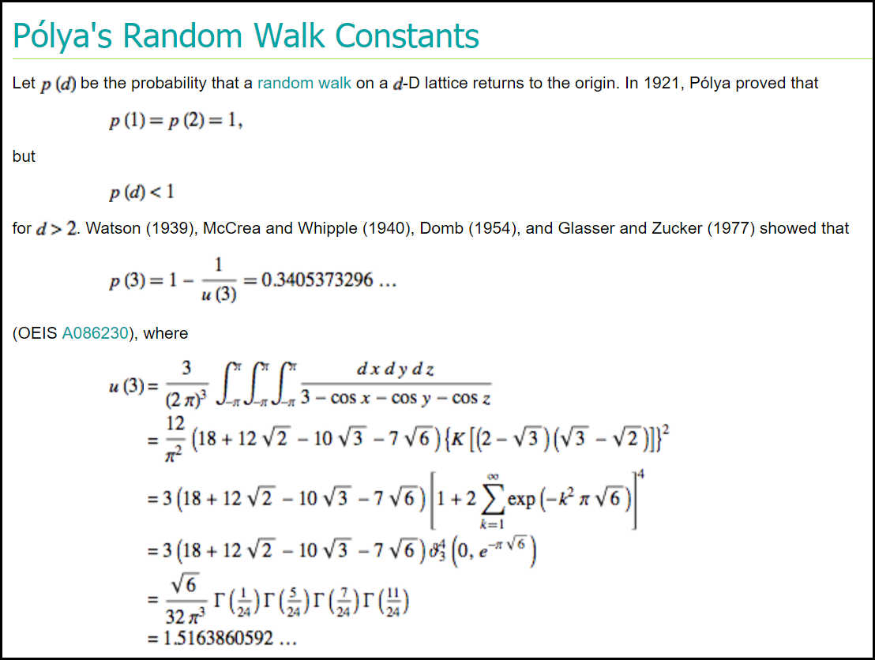

Slide 5
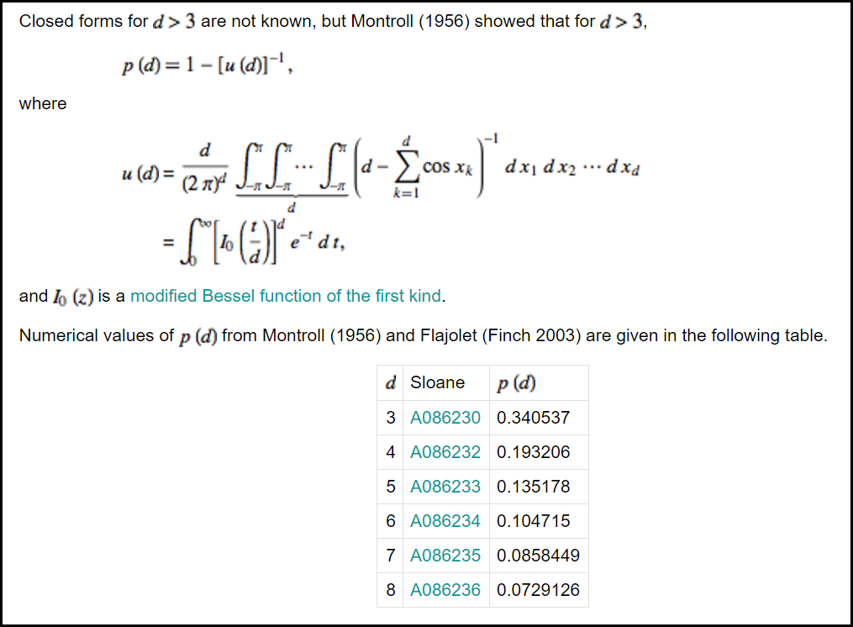

Slide 6
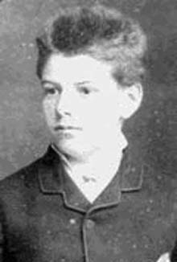
Louis Bachelier (1870-1946)
Ph.D Thesis (1900): "Théorie de la Spéculation" Annales de l'Ecole normale superiure
Inspired by Brownian motion he introduced the idea of a “random-walk” to model the price of what is now called a barrier option (an option which depends on whether the share price crosses a barrier).

Slide 7
Louis Bachelier (continued)
The “random-walk” model is formally known as “Wiener (stochastic) process” and often referred to as “Brownian Motion”
This work foreshadowed the famous 1973 paper by Black and Scholes “The Pricing of Options and Corporate Liabilities”
Bachelier is widely considered as the inventor of Mathematical Finance (and specifically of Option Pricing Theory)

Slide 8
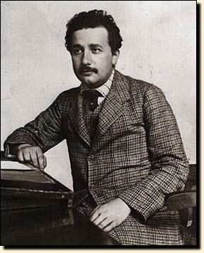
Albert Einstein
Worked out a quantitative description of Brownian motion based on the Molecular-Kinetic Theory of Heat
Published as the third of 3 famous three 1905 papers
Awarded the Nobel Prize in 1921 for “proving” the existence of molecules

Slide 9
Random Walk
Einstein analyzed the Brownian Motion of particles suspended in water as a 1-d random walk process.
Einstein was able to show with his own analysis that this random walk problem is identical to the 1-d diffusion problem – thus confirming Bachelier’s intuition

Slide 10
Random Walk (continued)
The 1-d diffusion equation is
This equation has the Green’s Function (integral kernel) given by
This provides the expected concentration of particles as a function of time if they all start at the origin

Slide 11
Random Walk (continued)
Taking the initial position of each particle to be its origin, the average x² is then given by:
Einstein finishes the paper by suggesting that this diffusion constant D can be measured by following the motion of small spheres under a microscope
From the diffusion constant and the known quantities R, η , and a, one can determine Avogadro’s number N

Slide 12
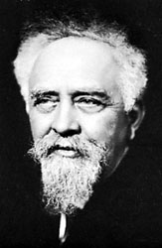
Jean Perrin (1870-1942)
Jean Perrin began quantitative studies of Brownian motion in 1908
Experimentally verified Einstein’s equation for Brownian Motion
Measured Avogadro’s number to be N = 6.5-6.9x10²³
From related work he was the first to estimated the size of water molecules
Awarded Nobel Prize in 1926

Slide 13
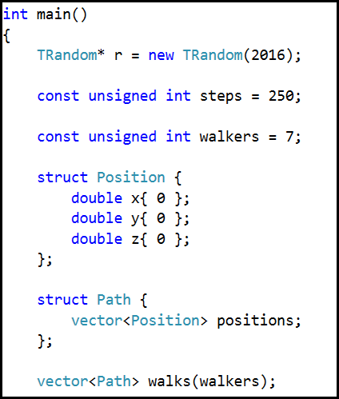
Lab 1 - Generating a Random Walk

Slide 14
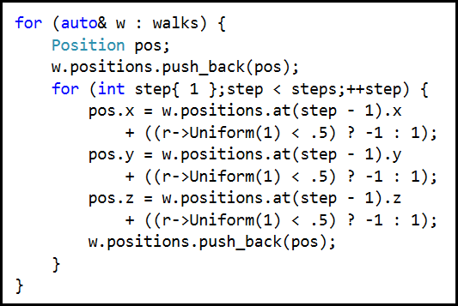
Lab 1 - Generating a Random Walk

Slide 15
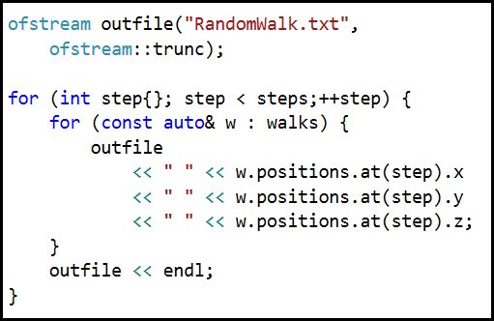
Saving the walk data in TEXT format

Slide 16
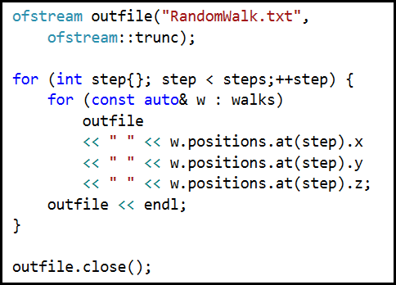
Saving the walk data in TEXT format

Slide 17
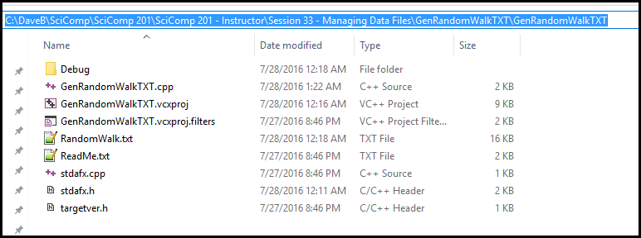
Saving the walk data in TEXT format

Slide 18
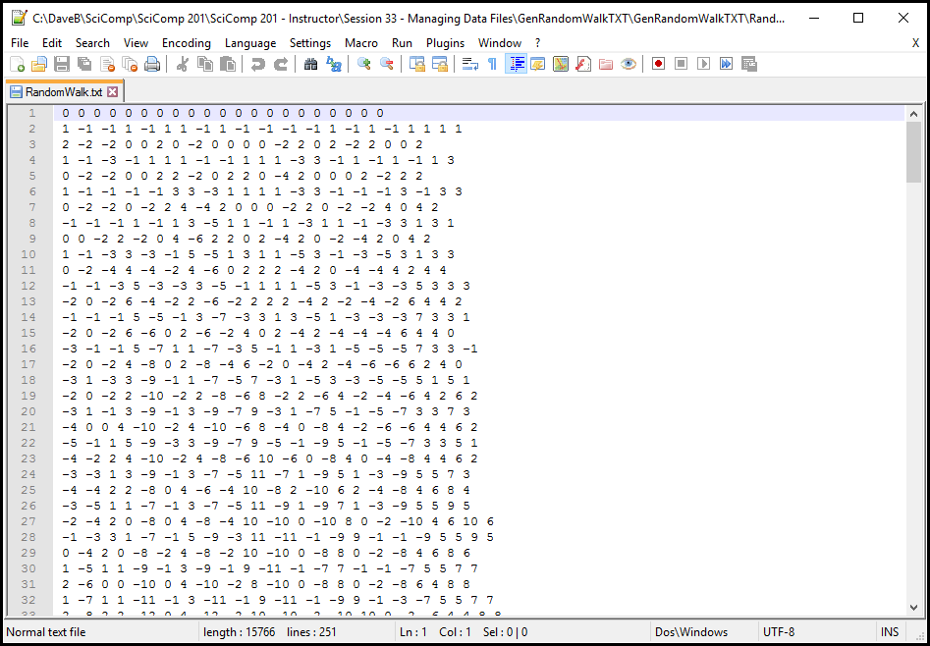
Saving the walk data in TEXT format

Slide 19
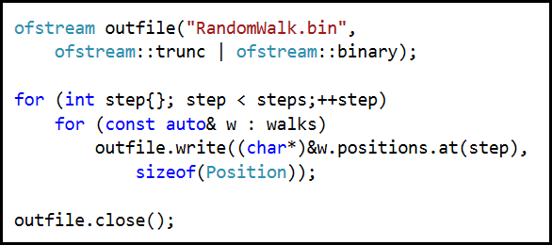
Lab 2 – Saving data in BINARY format

Slide 20
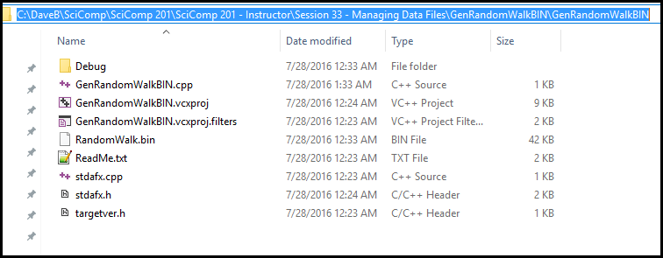
Lab 2 – Saving data in BINARY format

Slide 21
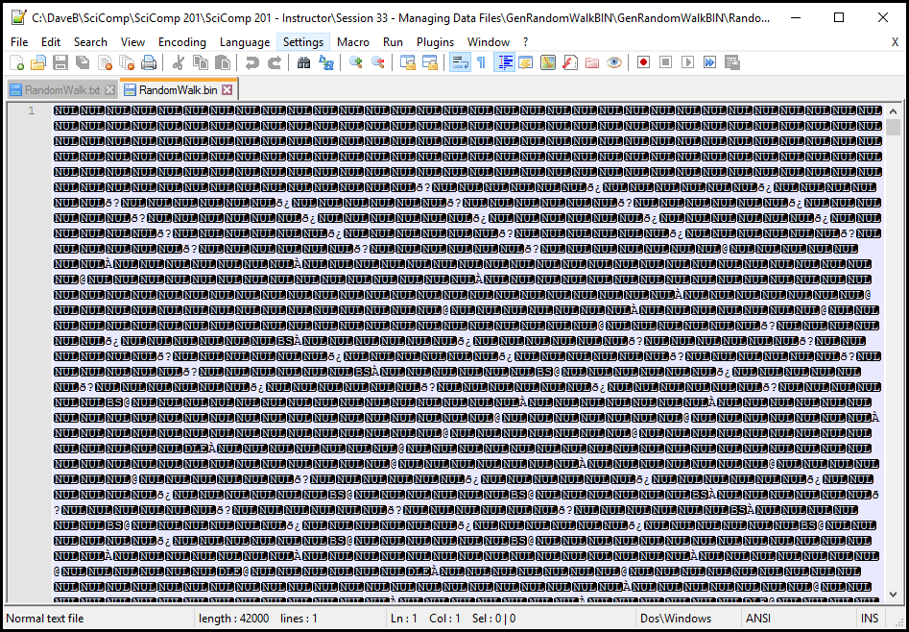
Lab 2 – Saving data in BINARY format

Slide 22
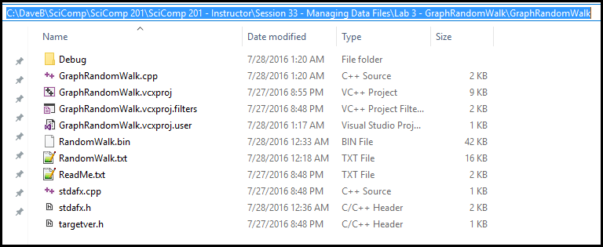
Copy the data files to the Lab 3 project folder

Slide 23
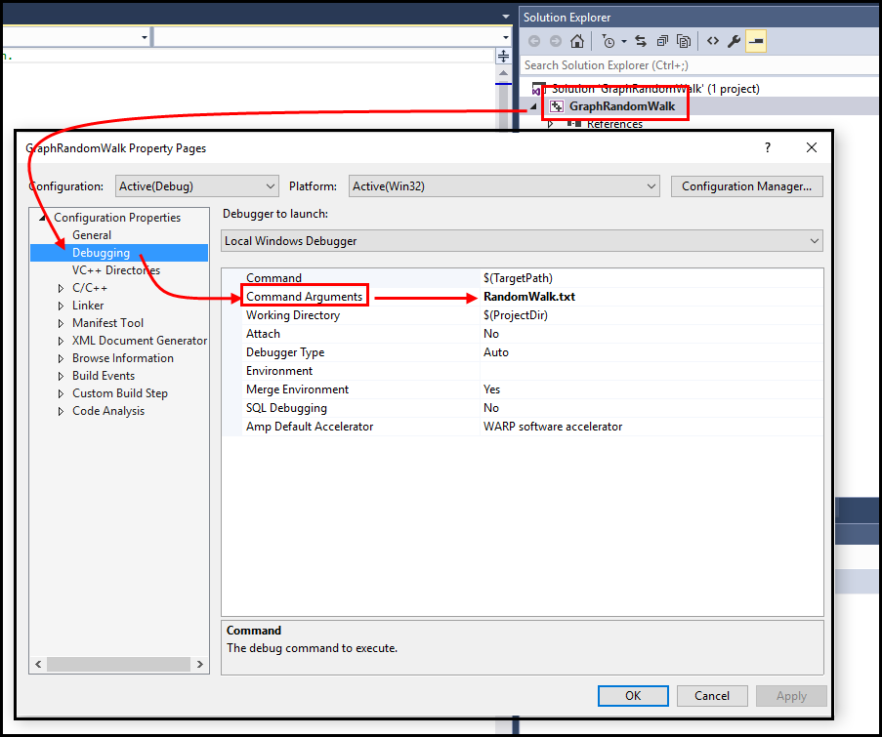
Setting DEBUG Command Arguments

Slide 24
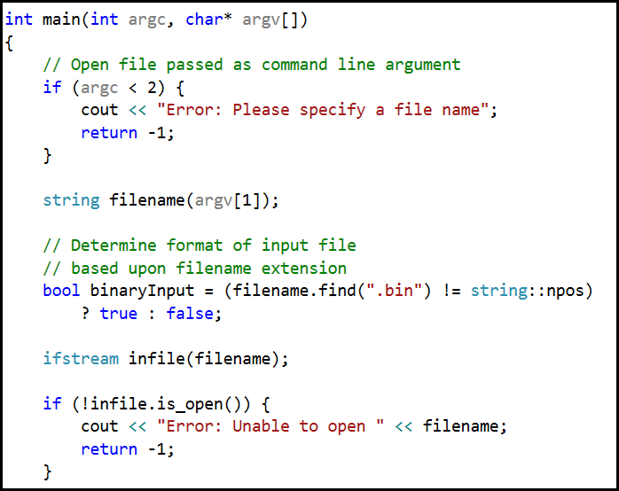
Lab 3 – Graphing the Random Walks

Slide 25
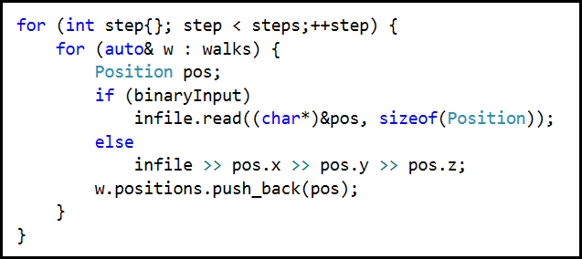
Lab 3 – Graphing the Random Walks

Slide 26
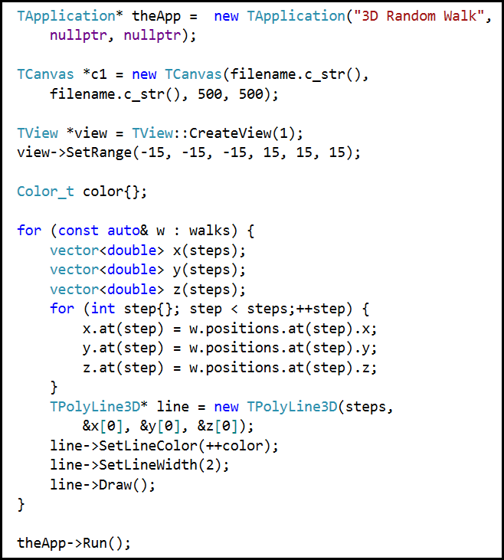
Lab 3 Graphing the Random Walks

Slide 27
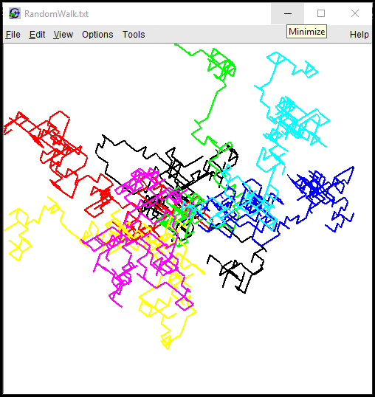

Slide 28
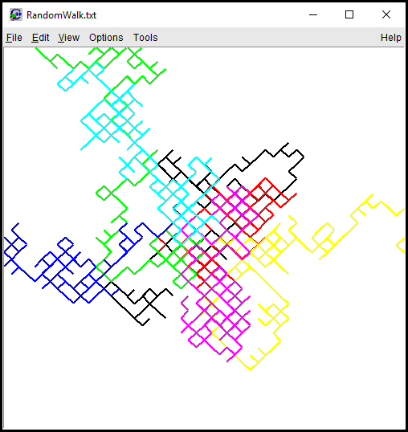

Slide 29
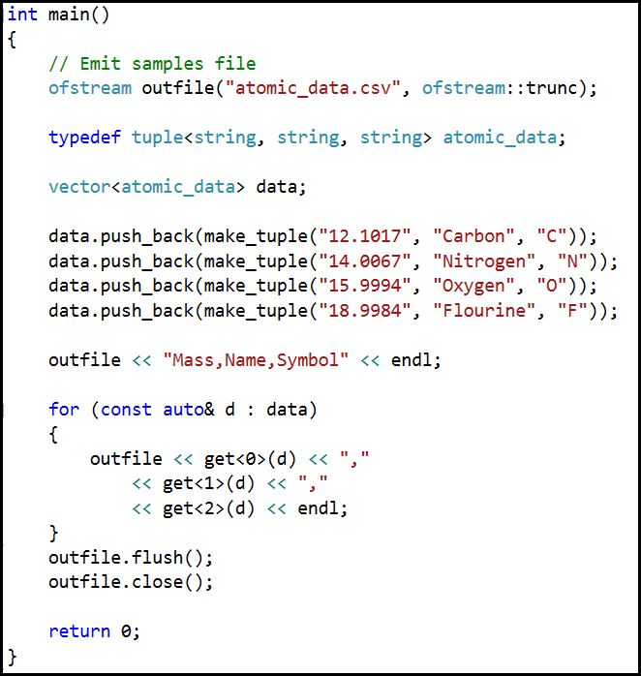
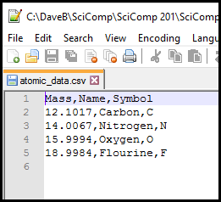
Lab 4 Generating CSV files

Slide 30
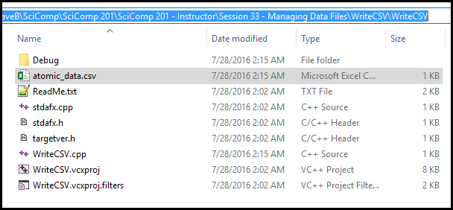
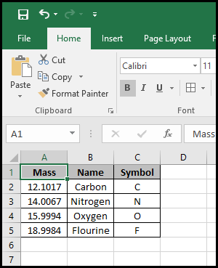
Lab 4 Generating CSV files

Slide 31
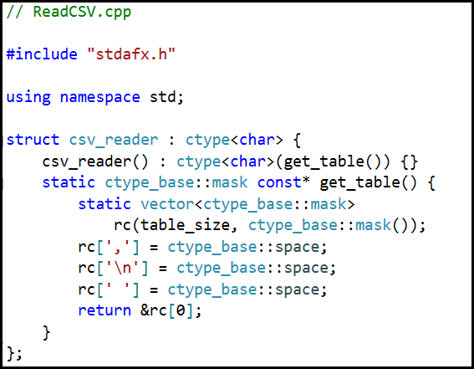
Lab 5 Reading CSV files

Slide 32
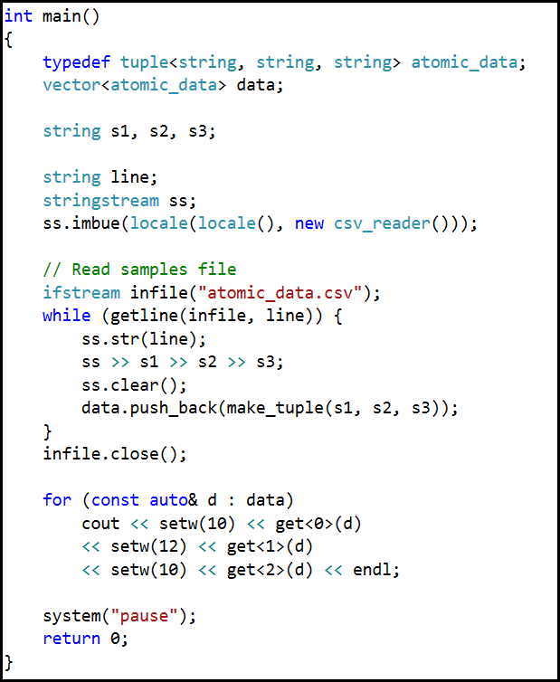
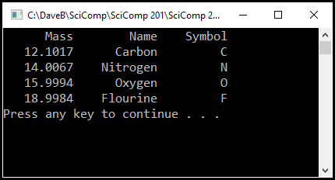
Lab 5 Reading CSV files

Slide 33
Now You Know…
Random Walks are at the basis of molecular dynamics
How to read & write C++ data files using stream operators
Text mode = likely in ASCII or UTF-8, editable in Notepad
Binary mode = encoded, unreadable by text processors
How to generate and parse files using the comma separated values (CSV) format
Delineates distinct columns with a comma
Easy import/export with Excel and most applications

